Slide 1

HTML TAGS

Slide 2
<!DOCTYPE html>
The DOCTYPE tells the browser what kind of file will be opening. Since we are coding in HTML5. HTML5 is the latest version of the HTML Markup language; our DOCTYPE is extremely simple. Notice, There’s no closing tag.
DOCTYPE is just like a regular tag and starts with a bracket, and then we put in the exclamation point, and then we type DOCTYPE. We have space, and then we type html. This tag is basically telling the browser, hey, these documents need to be served as HTML.

Slide 3
<html> </html>
The HTML tag, also called the root element, follows the DOCTYPE tag. This tag can have the normal global attributes plus an attribute called manifest. The HTML tag can only be used once on an HTML page.
Everything HTML-related is nested inside this tag. This means that all of our tags will be located between the opening and closing of the HTML tags.

Slide 4
<head> </head>
The head tag provides general information about the web page that is being displayed. An individual tag is added inside of the head tag, which lets the browser know certain specifics, such as the title of the page, author of the page, and other such information.
Nothing in this head tag will be displayed on the web page. However, some information is displayed in the actual browser application, such as the tab title. It is standard global attributes are available for this tag.

Slide 5
<body></body>
The body tag lets the browser know what to display on the page. Inside the body, the tag is where we will place all of our content, such as tags and text. Anything placed inside of the body tag will be displayed on the web page.
The body tag is placed after the head tag inside of the HTML tag. There is only one body tag per page. The body tag can have standard global attributes.

Slide 6
<span></span>
Our first tag is the span tag. This tag is a generic, Inline container. That means it has no default style associated with it. You would want to use this tag if you needed to group texts that you want to keep together inline.

Slide 7
<p></p>
This is Paragraph tag. The paragraph tag, or the p tag, is used when you want to keep a paragraph of text together. This element is a block-level element, meaning it takes up the width of its parent container. The ideal use would be when you have a lot of text to display. Only global attributes are permitted for this particular element

Slide 8
<div></div>
The paragraph tag, or the p tag, is used when you want to keep a paragraph of text together. This element is a block-level element, meaning it takes up the width of its parent container. The ideal use would be when you have a lot of text to display. Only global attributes are permitted for this particular element

Slide 9
<sub></sub>
The subscript tag, or the subtag, allows the next to be below the normal line of text. It’s an Inline element as it uses global attributes. A perfect example of usage would be to make the 2, in the H2O, appear little.
Example: H₂O

Slide 10
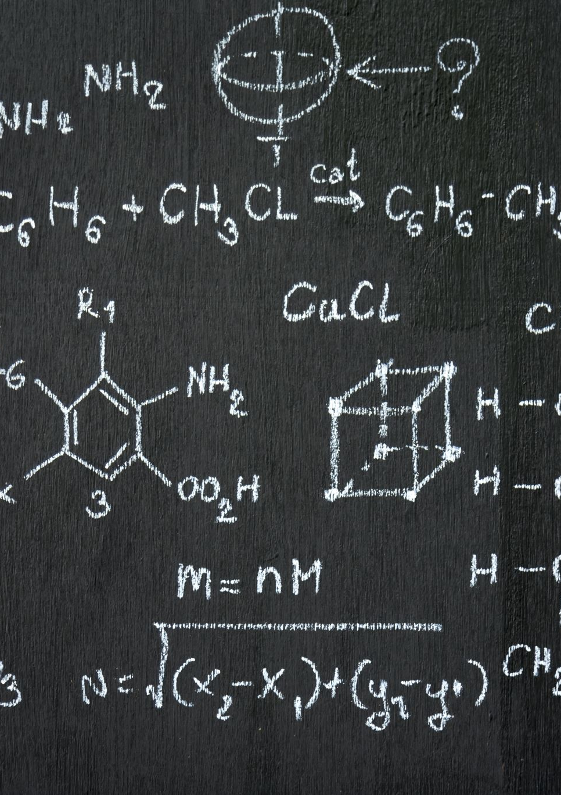
<sup></sup>
The superscript tag, or the sup tag, which is an inline element, allows for the text to be above the normal line of text. An example would be when dealing with a math equation. Notice that the 2 is higher than the rest of the text in this equation.
Example: E = mc²
This is a global attribute.

Slide 11
<u></u>
U stands for underline. This will underline any text within the open and closed tags. It’s an inline element and global attribute.

Slide 12

<em></em>
The em tag stands for emphasis. In this case, the idea of emphasizing any text will make the text look italic or slanted. This inline element is used when you want to express certain emphasis on parts of your text. This is a global attribute.

Slide 13
<strong></strong>
If you ever want to make any text bold, you would use the strong tag. This inline tag is placed around the text you would want to make bold, just like the emphasis tag. The strong tag gives added importance to the text on your website.

Slide 14
<br>
The BR tag standing for a break. There are a few tags that don’t need a closing tag. It’s neither block and inline element. It is a global attribute.

Slide 15
<hr>
The hr tag also does not need a closing tag to complete it. The hr tag, which stands for the horizontal rule, will create a line on the web page. It’s a block-level element. It’s a global attribute.
Nested Elements/Tags
Nesting tags
Where one tag is inside of another tag

Slide 16
<li></li>
The li tag standing for a list item is the tag that will be nested. Inside the li tag, you would put any type of content that is a list.

Slide 17

<ol></ol>
The ol tag, standing for the ordered list, is a container of the nested li tag. You will never see these two tags, the li or the ol tag, by themselves. Since this is a list of orders, that means next to each item in the list, there will be a value.
By default, the list will use numbers.
Attributes
Global, reversed, start, type (a, A, I, i)

Slide 18
<ul></ul>
The ul tag, or the unordered list, is a container for the nested li tag, just like the ol tag. But unlike the ol tag, which displays a number value next to each of the items in the list, this ul tag just provides bullet points next to the list items in the list.

Slide 19
Tag – h1,h2,h3,h4,h5,h6
There are six total header tags. Each of these with its own number, starting at 1 down to 6. The h1 tag and all the other header tags provide a brief description for a section of text or content. These tags are global attributes.

Slide 20
<a></a>
The tag, or the anchor tag, is a popular tag because it creates links to other pages on a website, and it can create links to outside websites. The tag is an inline element and has a plethora of attributes besides the global attributes associated with it.
The one additional attribute we will mention is a href. This stands for Hypertext Reference. The main thing to remember is that the href is the attribute where we provide the path so we can link to another page or another website.
The attribute, href. And we always want to put our closing tag. Link back to the Google.com website
<a href=http://Google.com>Hello World!</a>

Slide 21
<img src=””/>
The img tag, or the imNow you will notice in the example here that the image tag does not have a closing tag. This is one of the handfuls of tags. But unlike the br tag and the hr tag, we signify the ending of this tag with a forward slash. Some might actually refer to this as the shorthand way to write a closing tag.
The src attribute and the alt attribute. The src, or the source attribute, as you see in the example, is required.
Now the value of this attribute is the path to the photo we would like to display. The path can be either an absolute path or a relative path. The other attribute is the alt attribute. This stands for an alternative. The alt value should describe the photo. The alt text will be displayed in the browser as below .Age tag, gives us the ability to display images on our page.

Slide 22

<i></i>
Here, the <i> and </i> are the HTML tags and “Italic Tag” is the HTML element (the on-page text.)
This tag will format any text between the opening <i> tag and the closing </i> tag as italic.

Slide 23

<audio>
Defines embedded sound content

Slide 24

<col>
Set the background color of the three columns with the <colgroup> and <col> tags:

Slide 25

<canvas>
Used to draw graphics, on the fly, via scripting (usually JavaScript)

Slide 26
<base>
Specifies the base URL/target for all relative URLs in a document.

Slide 27
THANK YOU MAM!
Presentation by,
M.HARINILAXMI
21BTYE012
BIOTECHNOLOGY DEPARTMENT
II UG

